Slide 1
Machine learning Project Proposal
Arabic digits recognition project

Slide 2
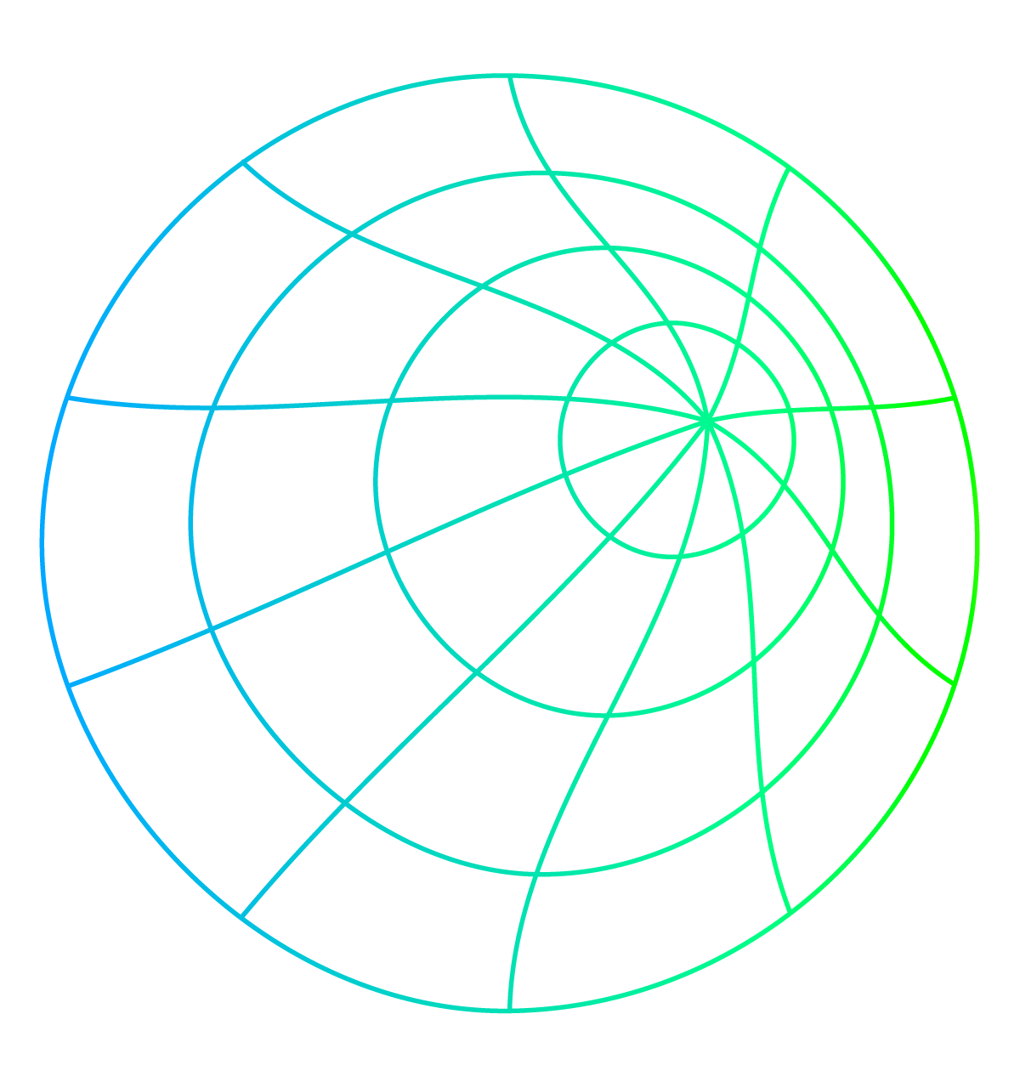
TABLE OF CONTENTS
01
02
03
04
About the project
Major requirements
ANN and CNN
Compairing between results

Slide 3
INTRODUCTION
In this project, we discuss the use of machine learning algorithms using CNN and ANN models and use the evaluation metric for each model to find the best one

Slide 4
01
About the project
Handwritten project

Slide 5
WHAT WE ARE WORKING ON
Arabic MNIST DataSet
We upload the data from Kaggle, It’s about the arabic digits images.
Packages and Resources
Numpy, Matplotlib, Tensorflow, .
Kaggle notebooks..
Building the model
We splited the data for train and test.
Build ANN and CNN model.
Find which algorithm is better for training the model and make prediction.

Slide 6
DATA PROJECT ARCHITECTURE
Arabic MNIST
Clean
Normalizing
Algorithms
Modeling
Accuracy
Compare

Slide 7
02
Major requirements
The packages and requirement

Slide 8
THE PROJECT STEPS
Used NumPy, Matplotlib and Keras TensorFlow package to start our project
Apply ANN and CNN models
Build the model and our evaluation metric
Plot some visuals for our work
How our plan is organized:

Slide 9
1) Cleaning Data
First: Check for Null values and duplicates
Make all picture at the same size
Normalizing picture
Plot some visuals for our work

Slide 10
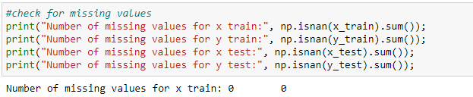
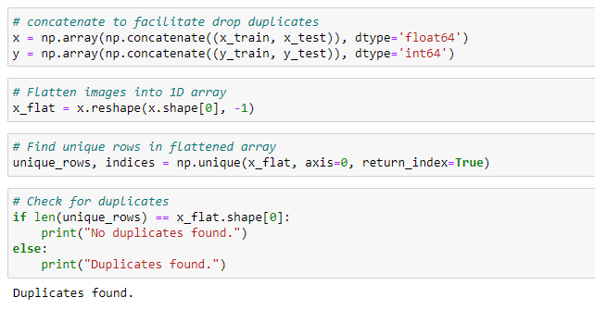
1) Cleaning Data

Slide 11
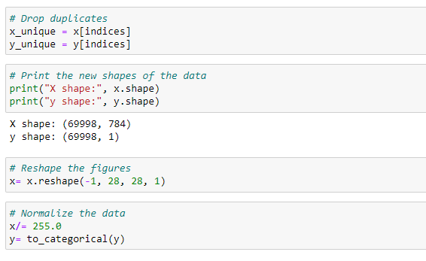
1) Cleaning Data

Slide 12
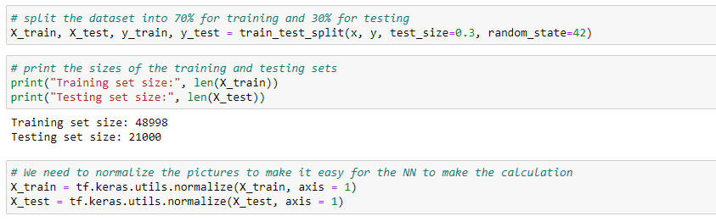
2) Preparing data for our model

Slide 13

Artificial Neural Network
1) CLASSIFICATION ALGORITHM

Slide 14
| ANN ALGORITHM
Define the architecture of the ANN
Compile the model
Train the model on the Arabic mnist dataset
Calculate the accuracy

Slide 15
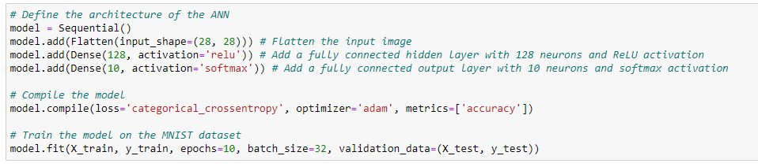
| Artificial Neural Network (ANN)

Slide 16
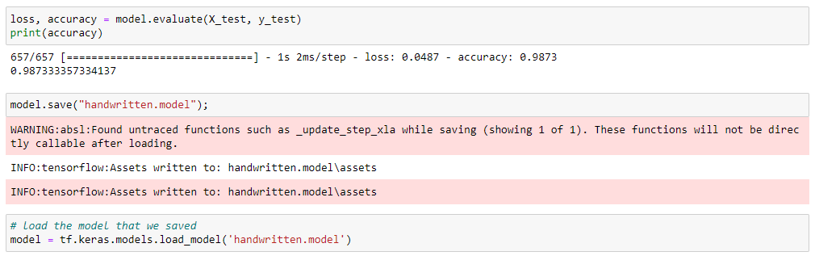
| Artificial Neural Network (ANN)

Slide 17
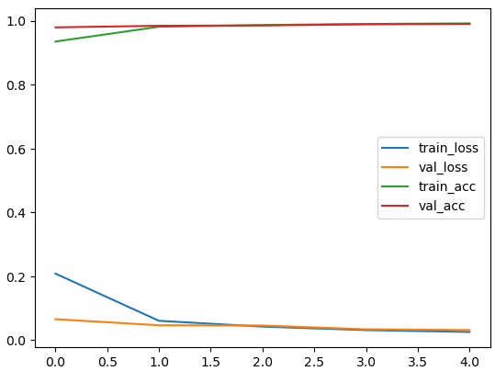
| ANN ALGORITHM
we visualized the performance of the neural network during training to identify potential issues such as overfitting or underfitting.

Slide 18
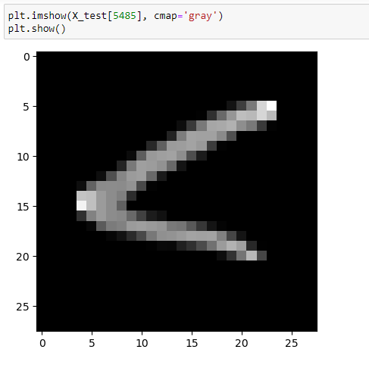

| Artificial Neural Network (ANN)

Slide 19
Convolutional Neural Network

Slide 20
| CNN Algorithm
Define the architecture of the CNN
Compile the model
Train the model on the Arabic mnist dataset
Calculate the accuracy

Slide 21
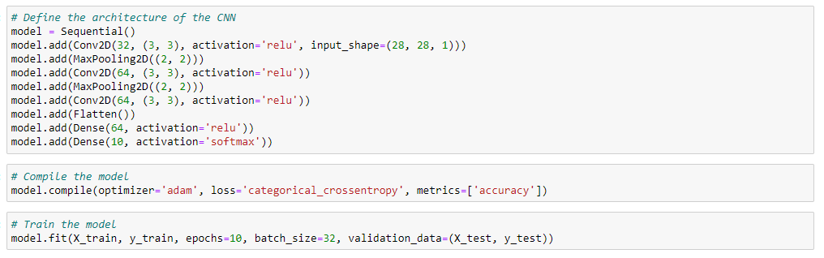
| Convolutional Neural Network

Slide 22
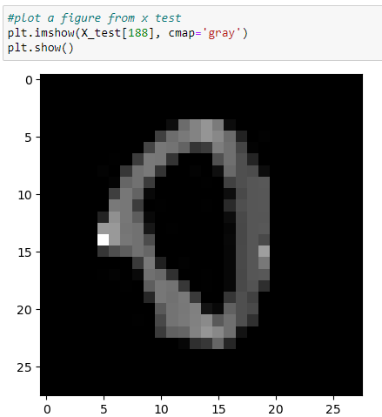

| Convolutional Neural Network

Slide 23
Evaluation Metric

Slide 24
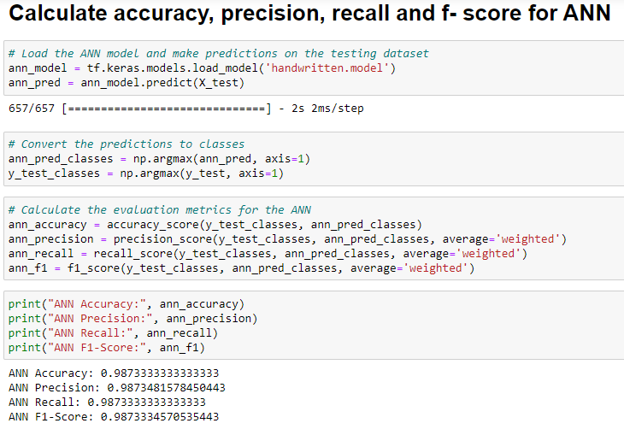
| ANN OR CNN

Slide 25
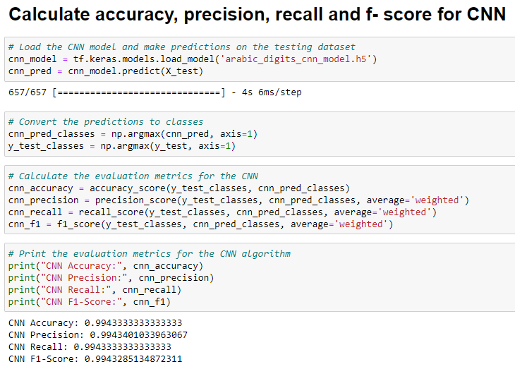
| ANN OR CNN

Slide 26
Which one is the Best?

Slide 27
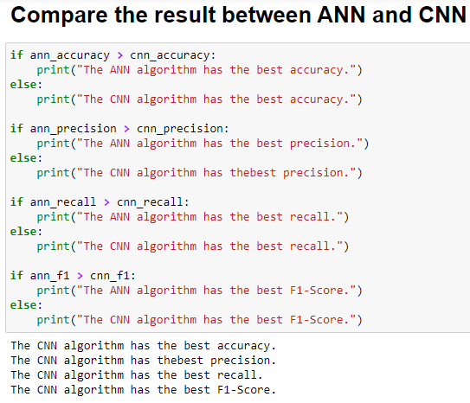
| ANN OR CNN

Slide 28
THANKS!
Have any questions?

